Slide 1
Data Analysis For Network Troubleshooting
Rakesh Balachandra
Mananga Mutombo
Purdue University Spring 2018

Slide 2
Project Scope
Detection of performance anomalies and optimal route estimation requires large volumes of data. Our scope is limited to collecting and analyzing trace route and ping data from 2-3 control hosts at Purdue University to 100 servers (in the US and around the world).
Project Direction
Our project direction changed a little bit. Initially we taught of classifying traceroute data based on the asterisk seen on paths but after receiving feedbacks from professor we changed the focus to finding trends between different traces and comparing morning to afternoon and night traces. We also decided not to analyze ping data since we are getting the same data from traceroute.

Slide 3
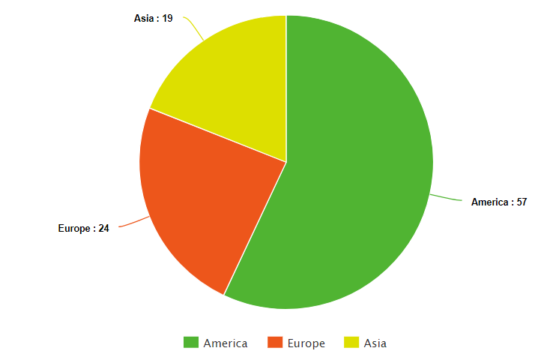
Design and Implementation
Data Collection
We have come up with a python script to automatically collect traceroute and ping data of approximately 100 servers across the world. The script pinged and traced each server and wrote the results in text files within their appropriate folders. The data collected was organized into morning set (6:00am – 11:59pm), afternoon set (12:00pm – 5:59pm) and night set (6:00pm – 12:00am). Within each set of data, we classified data into America, Asia and Europe traceroute and ping data. Figure below shows distribution of servers by continents.

Slide 4
Data Organization
We implemented a Python script that took the data collected from the text file, processed it (i.e. clean up unwanted data, etc.) and uploaded it to MySQL database that we created and maintained.
The database was named “Network” and all the traceroute data of different servers was stored in the form of tables named after the different servers. We used MySQL data for ease of querying any data wanted.

Slide 5
Evaluation Methodology
Using python script, we calculated weekly average delay to reach ever server from a host machine on campus/off campus. This average was written to a text file. We also developed a MATLAB script to read and box-plot this data.
The same python script computed weekly average hope to reach ever server from a host machine on campus/off campus. This average was written to a text file. The same MATLAB script read and box-plotted this data.
We analyzed servers using CDN after in-class lecture on CDNs by utilizing our database and querying for each CDN provider. We plotted the percentage of servers using CDN for America, Asia and Europe.
We had a python script to calculate the send rate in a traceroute. If a traceroute have a hop with 1 asterisk in place of the round-trip time of the packet sent, then the send rate of that hop is 66% (i.e. 1 - 1/3). Similarly, if there are 2 asterisks the send rate is 33% otherwise it is 100%. If we observed 3 asterisks, then we ignored the hops.

Slide 6
We came up with a Python script that compared all IP addresses of each server across all traceroutes to determine if there is any alternate destination for the same server. If the IP addresses are different, there exists an alternate destination and we computed the number of those destination and plotted a percentile graph otherwise, there is no alternate destination.
The same python script which gives the number of different destinations also computes and outputs the destination with the least delay for servers with alternate destinations.
Using Python ‘Plotly’ module, we plotted destinations with least delay from source (i.e. on campus) to destination (i.e. a given server) on the map.

Slide 7
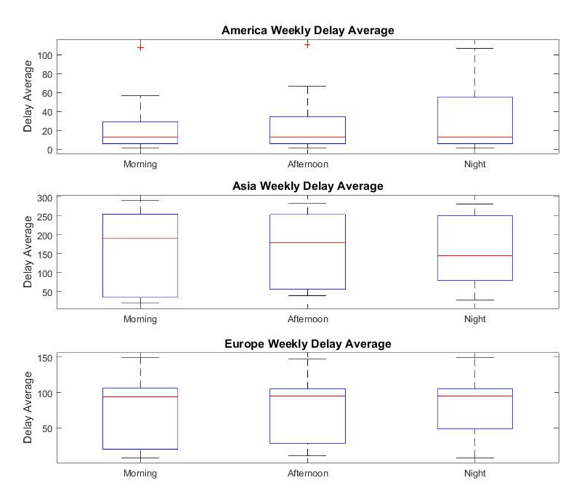
Results and Discussions
Average Delay Box-plot

Slide 8
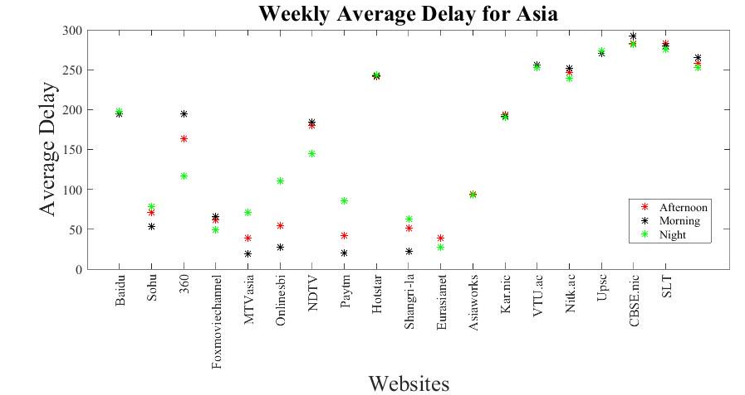
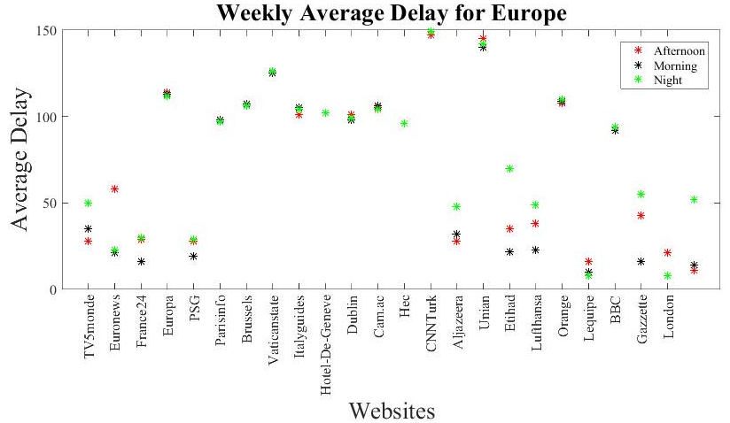
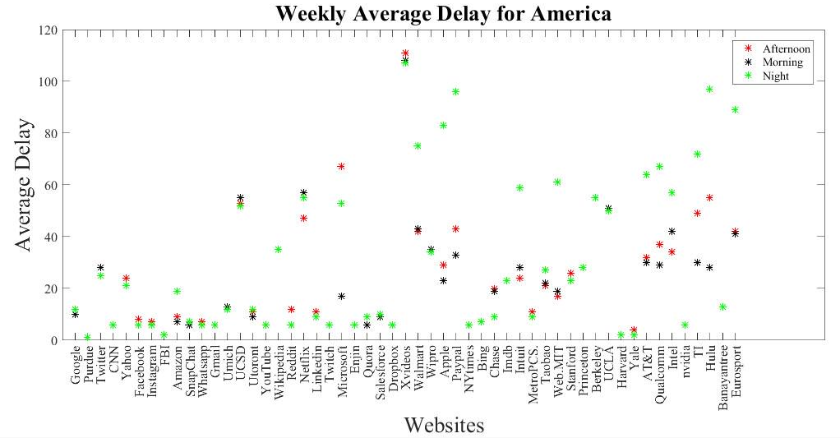
Average delay to reach each server

Slide 9
The above figure plots weekly average delay (RTT delay) of servers in America, Asia and Europe respectively and compares morning to afternoon to night. The results show that servers in America have the least mean delay in the range 15-20 MS while servers in Asia have the highest average delay ranging between 150-200 MS which is 10 times larger than servers in America. Servers in Europe have a mean delay between 100-110 Ms. There were some outlier points in servers in America such as Netflix, Hulu and YouTube which have higher delays than most other servers in America and this might be due to the fact that they have more traffic.
We also observed a sharp increase in the delay for servers in America and Europe during the night as compared to other cases, and this might be because traffic increases since people are home streaming videos, etc. We observed a significant decrease in the mean delay during night for servers in Asia. We concluded that this is because night time in the US is day time in Asia.

Slide 10
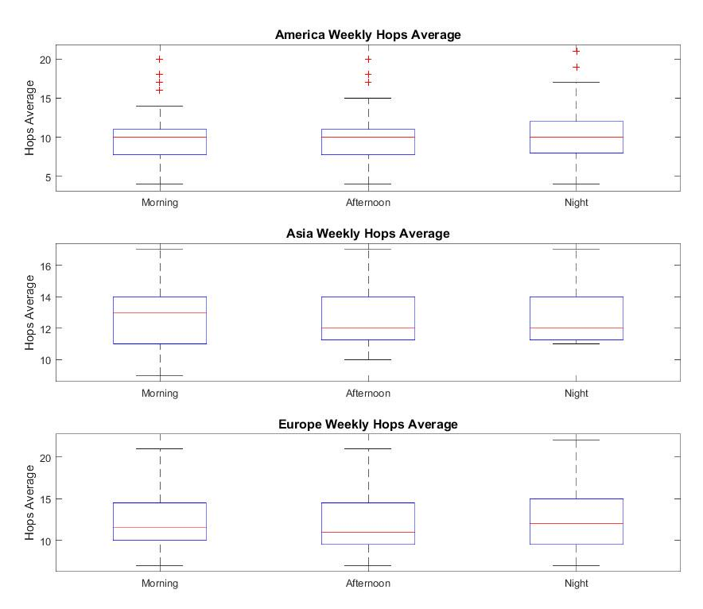
Box-plot of average Number of responsive hops

Slide 11
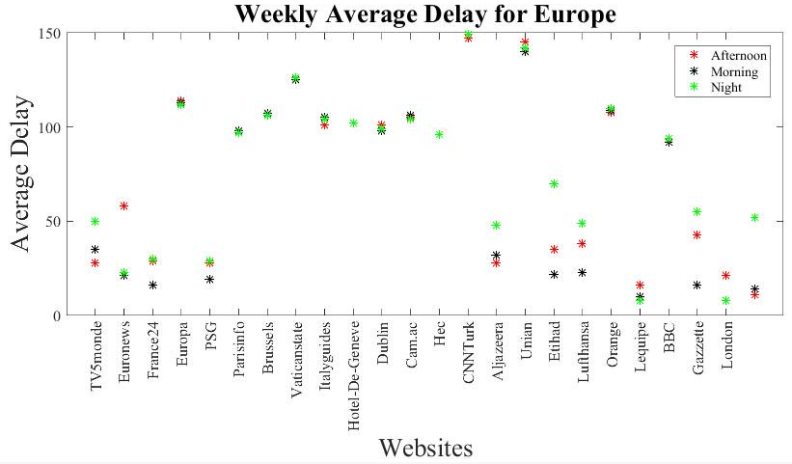
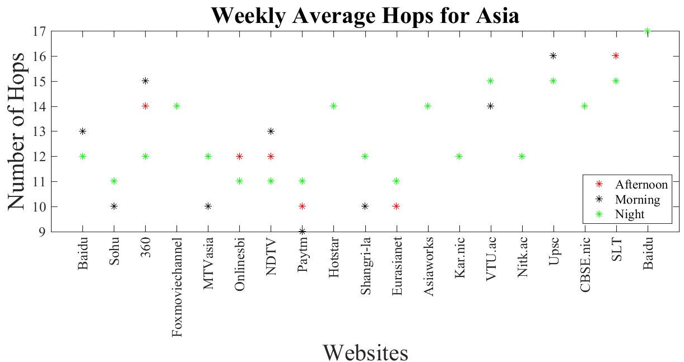
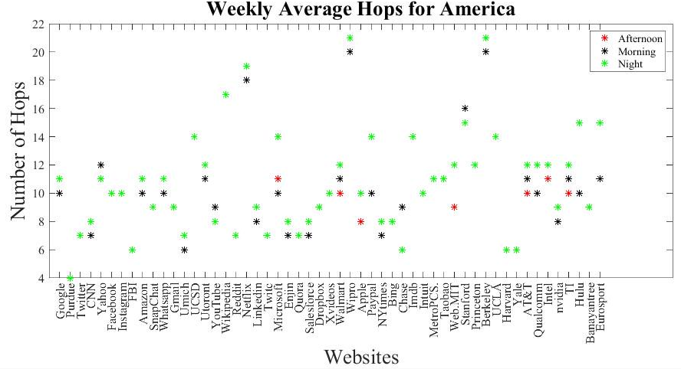
Average number of responsive hop for each server

Slide 12
The above figure plots weekly average number of responsive hops of servers in America, Asia and Europe respectively and compares morning to afternoon to night. The results show that servers in America have the least mean number of responsive hops in the range 9-10 hops while servers in Asia and Europe have mean number of responsive hops between 12-13. There were some outliers in the servers in America dataset with “Wipro”, ”UC Berkeley”, “Imdb” and “Netflix” having 20,20,16 and 17 hops respectively.
Across servers in Europe the number of responsive hops remained stable between morning, afternoon and night. We did see a gradual increase in the maximum number of responsive hops as the day progressed for servers in America and a gradual increase in the minimum number of responsive hops for servers in Asia.

Slide 13
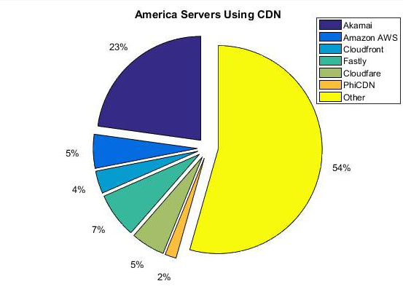
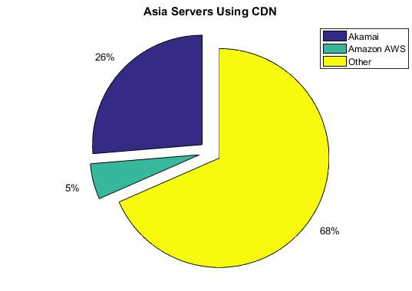
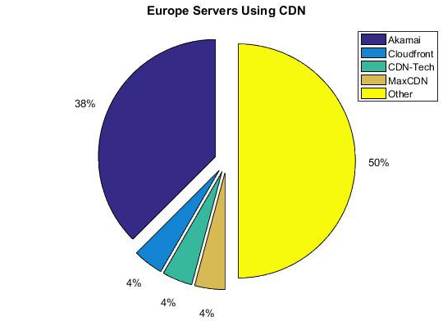
Content Delivery Network

Slide 14
Our CDN analysis shown in the above previous figures shows that approximately 46% of servers in America used CDN and the remainder host their own content; 31% of servers in Asia use CDN compared to 68% that host their own contents; and lastly, 50% of servers in Europe use CDN whereas the other 50% host their own contents.
We observed that Akamai Technology is the most popular CDN used across servers using CDN with 70.6% followed by Amazon AWS with 13% usage. Most Universities and government servers host their own contents where big and major corporations have their contents host by CDN providers such as Akamai or Amazon.

Slide 15
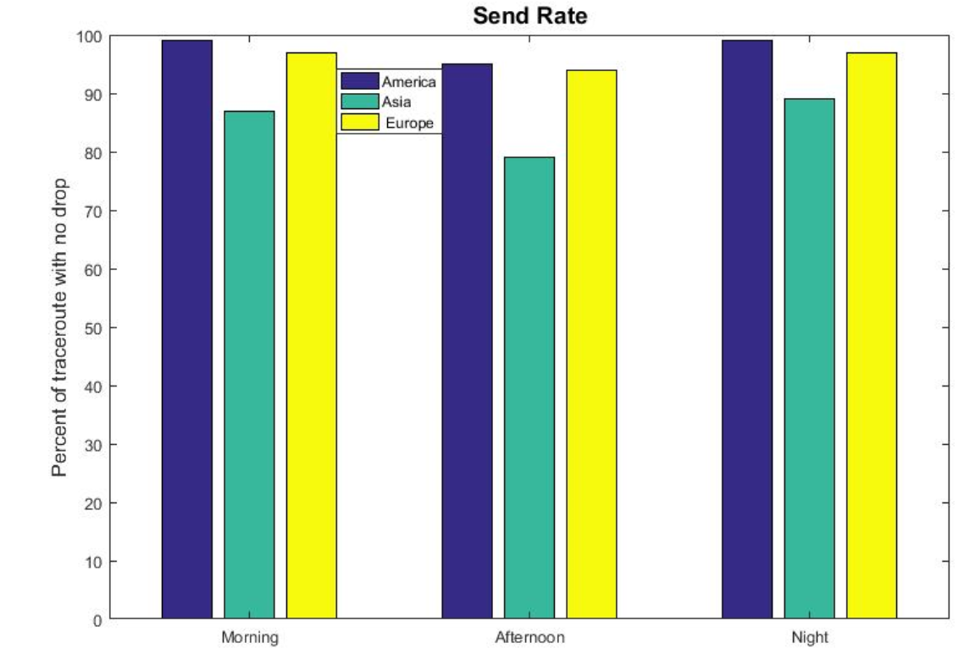
Send Rate
This figure shows traceroutes which had a 100% send rate out of all traceroutes.

Slide 16
From the figure above, we notice that about 97% of the traceroutes collected for servers in America have no packet drop in all hops. While 84% and 95% of traceroute for Asia and Europe respectively have no packets drop in all hops. We had about 3500 traceroutes in total for all servers in America, Asia and Europe.
All servers experienced a drop in the send rate during the afternoon.
Servers in Asia with biggest packet drops were www.360.cn, www.vtu.ac.in and kar.nic.in. Some servers in America with biggest packet drops were Walmart and Netflix.

Slide 17
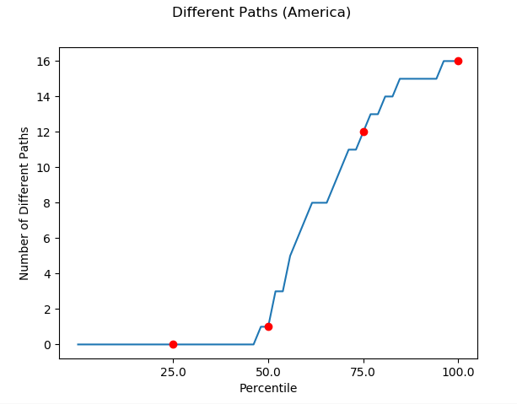
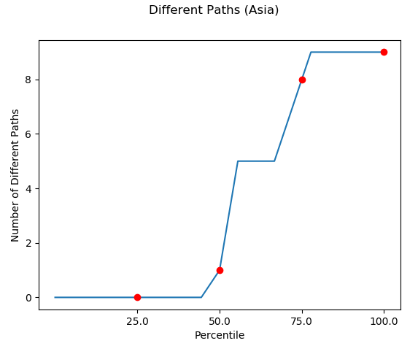
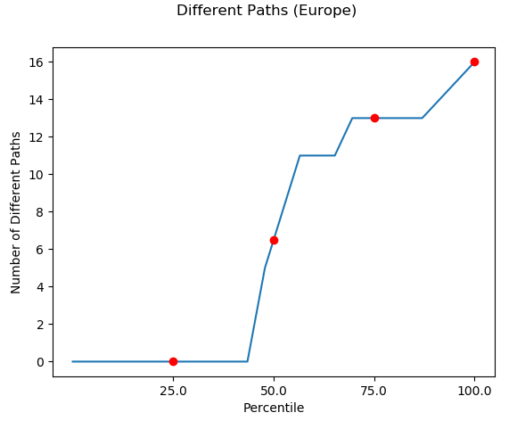
Alternate Destinations

Slide 18
Alternate destination analysis, shows that around 48% of servers in America have no alternate destination while 52% have between 1-16 alternate destinations. Approximately 46% of servers in Asia have no alternate destinations whereas 54% have between 2-10 alternate destination. About 45% of servers in Europe have no alternate destinations and 55% have 1-16 alternate destinations.
Some servers in America with alternate destinations ranging from 11-16 are Walmart, Amazon, Google and PayPal while servers like Facebook, FBI and Twitter had no alternate destinations. Similarly servers in Asia such as Hotstar, Paytm, foxmoviechannel had high number of alternate destinations while servers such as Baidu, Sohu and Asiaworks had no alternate destinations. Servers in Europe such as Gazzetta, Aljazeera and Euronews had the highest number of alternate destinations while servers such as Hec, Europa and Dublin had no alternate paths.
From the above analysis, we concluded that servers in Asia have less alternate destinations compared to servers in America and Europe.

Slide 19
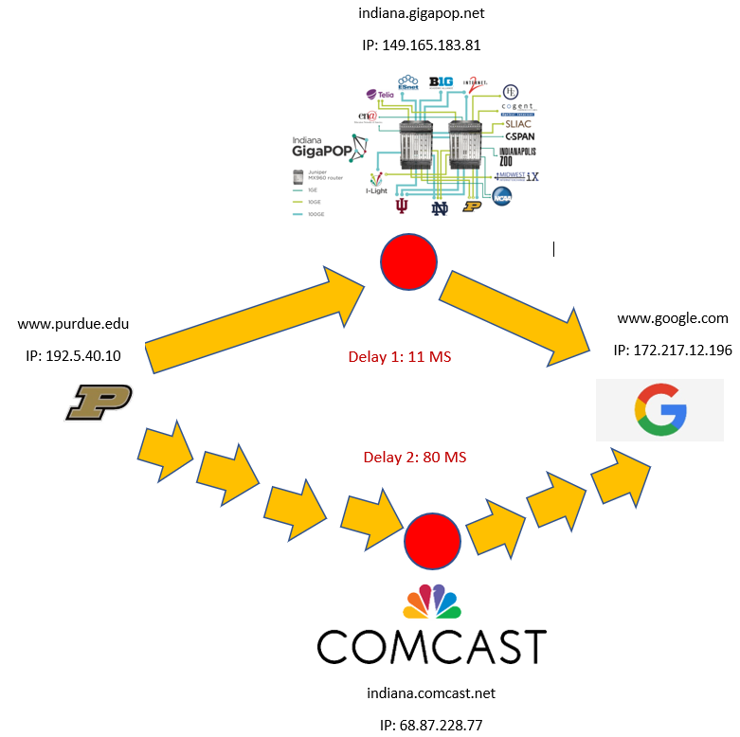
“Indiana.gigapop.net” vs “Indiana.comcast.net”

Slide 20
Most of the analysis in this report was done with data collected on campus, but we also collected data off campus and the analysis on off campus data gave us an insight into a common bottleneck for off campus traffic as well as what could be a bottleneck for on campus traffic as seen in the previous picture.
From the analysis of both data sets (i.e. on campus and off campus), we observed that all traceroute from source on campus to all servers passes though Indiana.gigapop.net whereas all traceroute from source off campus to any server passes through Indiana.Comcast.net.
We also observed that it takes about 7x time to reach a destination for servers in America through Comcast as compared to Gigpop and we think this is because “Indiana.gigapop.net” is only used by selected institutions therefore has less traffic compared to “Indiana.Comcast.net” which is used by Comcast customers across Indiana. The delays were same for servers in Asia and Europe.

Slide 21
Destinations with the least delay
The link below point to the map of closest alternate destinations for servers with alternate destinations
Link: https://plot.ly/create/?fid=balachandrarakesh%3A2

Slide 22
Role of each team member
Rakesh Balachandra
Developed the python script to collect traceroute and ping data from 100 servers
Developed the python script to export collected data to MySQL server database
Developed the python script to perform data calculations such as average delay and hops, change of destination, closest destination and send rate.
Mananga Mutombo
Developed MATLAB and Python scripts for data analysis (i.e. generate all the plots as well as figure generated using Python plotly module), and created analysis for the mid-point report.
Came up with a data classification scheme and collected data for all sets.
Brainstormed possible data analysis scenario, scalability of MATLAB analysis script and potential challenges as we get more data for analysis.

Slide 23
Thank You

